Slide 1
OVERVIEW OF UK GOVERNMENT DEPARTMENTS

Slide 2
WHAT ARE THE DIFFERENT TYPES OF GOVERNMENT ORGANISATIONS IN THE UK?
Public sector bodies in the UK can broadly be categorised across 5 groups
Main focus of this document
24
Ministerial Departments
Main government departments responsible for specific areas of public policy, government function, and public service
There are other organisations that engage with influencing government policy, e.g., GFI
20
non-ministerial departments
Operate independently of ministerial control and are responsible
for specific functions
427
agencies and other public bodies
Organisations that carry out specific
functions on behalf of the government
113
high profile groups
Task forces or advisory groups set up
to address specific challenges that include experts from various fields
3
devolved
administrations
Regional governments in the UK
that have been granted varying degrees
of legislative power
Source: Gov.UK

Slide 3
WHO HOLDS THE POWER?
ALBs/public-facing bodies
Key features of the “web” of UK&I central government
3
1
Centre of the web: fast-paced, civil servants have more portfolio/greater responsibility. Where “key conversations happen”
FCDO’s power shifts depending on the topic, but generally seen to wield greater control than delivery departments
Delivery depts: perceived to be slower- paced, more machine-like; vulnerable to organisational inertia, but some teams buck that trend
ALBs: considered to be furthest removed from policy, but also closer to frontline delivery
Delivery departments
2
2
3
3
4

Slide 4
WHAT DOES A ‘TYPICAL’ UK GOVERNMENT DEPARTMENT LOOK LIKE?
A standard government department is split into multiple directorates (divisions, groups, units, etc.)
Names vary by department, and can be called
divisions, groups, units etc
Policy-facing directorates
Department-wide strategy units
Priority projects units
Corporate directorate
Ministerial
and communications
Specialised units within a government department
that focus on ensuring that there is a “big picture and coordinated approach” to policy making, delivery
and financial decisions
Formulate and coordinate the overall strategic direction of the department, aligning departmental objectives with government priorities and assess long-term challenges
Manage and deliver high priority key projects for the government,
e.g., support for unexpected events such as Ukraine, overseeing project planning, strategy, and execution
Administrative and operational aspects of governments e.g., HR and Finance, legal
advisers, commercial/ procurement, etc.
Manages the relationship between government ministers and the public, as well as internal and external communications.
Includes ministerial and senior official private offices, press office, and internal comms and correspondence functions
Team sizes across directorates will vary significantly depending on the department priorities, etc

Slide 5
THE TRANSFORMATION PROCESS

Slide 6
BUDGETARY CYCLES IN UK GOVERNMENT
There are numerous, overlapping processes which determine a department’s priorities and budget; they drive capacity to deliver transformation
MULTI-YEAR ANNUAL IN-YEAR
Spending Review (SR)
to set budgets
Spring/Autumn Budgets
to calibrate priorities
Emergency Statements
to respond to crises/change
FISCAL EVENTS
SR negotiations to agree budgets
Project-level Business Cases
(SOC, OBC, FBC)
Delegated Authority Limits
to assess new above-limit spend
SPENDING PROCESSES
Programme-level Business Cases
Main and Supplementary Estimates for adjustments
Top-down & bottom-up analysis of spend
Conduct annual
business planning
In-year monitoring
for under/over-spends
DEPARTMENTAL ACTIVITY
Draft high-level strategy and
business cases
Re-prioritise & operationalise
new policy announcements
Reserve Claims to HMT
to justify new pressures

Slide 7
TIMELINE OF UK GOVERNMENT SPENDING REVIEWS SINCE 1998
1998 2000 2002 2004 2006 2008 2010 2012 2014 2016 2018 2020 2022 2024 2025 2026 2027 2028
Comprehensive Spending review 1998
Spending review 2000
Spending review 2002
Spending review 2004 Comprehensive Spending review 2007
Spending review 2010
Spending review 2013
Spending review 2015
Spending review 2019
Next 1-year spending review to be launched in Oct 2024, 3-year
Spending review 2020
Spending review 2021
Spending review 2024
Spending review 2025
in spring 2025
Spending review by Labour government Coalition government Conservative government
Source: Institute for Government analysis of HM Treasury spending review documents, various, 1998-2021.
Financial years covered by spending review

Slide 8
CIVIL SERVANTS AND GRADES

Slide 9
WHO ARE CIVIL SERVANTS AND WHERE ARE THEY DISTRIBUTED?
Civil Servants (FTE) by departmental group
Q1 2024, core department and other organisations
Perspectives
100,000
As of March 2024, there were 510,00 full-time
equivalent (FTE) civil servants
Typically, the largest departments focus on “delivery” or providing services directly
to the public, e.g., MoJ is the largest department,
employing thousands of prison officers
Fluctuation in the overall size of the civil service since 2010, reflected in individual departments’ staffing numbers
90,000
80,000
70,000
60,000
50,000
Most saw their numbers fall after the 2010 Spending Review, before rising in later years
Some drivers of some of the recent expansions in the civil service include Brexit preparations and the pandemic,
Most significant driver of growth of the civil service since 2016 being the operational delivery profession
40,000
30,000
20,000
10,000
0
MoJ DWP HMRC MoD HO DfT CO Defra DHSC
DBT DLUHC DfE
FCDO DSIT DESNZ HMT DCMS
Core department 1 Other organistions 2
1. Core department taken as the relevant department excluding agencies 2. Other organisations taken as non-department roles Source: Institute for government, ONS
181

Slide 10
HOW ARE CIVIL SERVICE GRADES STRUCTURED?
There are broadly 5 Civil Service job grades
5 Civil Service Job Grades
Senior Civil Service (SCS) are the most senior grade in the civil service made up of the senior management team. Generally, directors are ultimately responsible for the policy work of their team and director generals oversee directors and work closely with the department’s ministers. Each department also has a permanent secretary as part of the SCS who supports the minister at the head of the department, acts as the accounting officer and is responsible for the day-to-day running of the department
Grades 6 and 7 civil servants tend to be experienced professionals with significant policy responsibilities. They are likely to be your working-level contacts for transformation programmes
Administrative officer/Administrative Assistant (AQ/AA) – most junior civil service grade. These roles tend to compromise administrative support and operational delivery roles, e.g., prison officers
Senior executive officer/higher executive officer (SEO/HEO) includes policy officers and officials with specific responsibilities
Executive Officer (EO) civil servants in this grade
offer business and policy support and include roles such as
executive assistants, HR, IT and communications specialists
Rank | Short name | Full name | Other depts | CO | DCMS | DfID | DWP | FCO | HMRC | HMT | MoD | MoJ
Most senior | SCS | Senior Civil Service | SCS4 SCS3 SCS2 SCS1 | Permanent Secretary Second Permanent Secretary Director Deputy Director
 | G6&G7 | Grades 6 and 7 | G6 | Band A | AU | A1 | G | D7 | G6 | E2 | B1 | A
G7 |  |  |  | Band A | A | A2 | F | D6 | G7 | E | B2 | A
 | SEO | Senior Executive Officer | SEO | B2 | B | A2L | E | C5 | SO | D | C1 | B
 | HEO | Higher Executive Officer | HEO | B2 | C | B1 | D | C4 | HO | D | C2 | C
 | EO | Executive Officer | EO | B1 | D | B2 | C | B3 | Officer | C | D | D
Most junior | AO/AA | Administrative Officer | AO | C2 |  | C1 | B | A2 | AO | B | E1 | E
 | AA | Administrative Assistant | AA | C1 |  |  | A | A1 |  |  | E2 | F
182

Slide 11
BEST PRACTICES IN GOVERNMENT

Slide 12
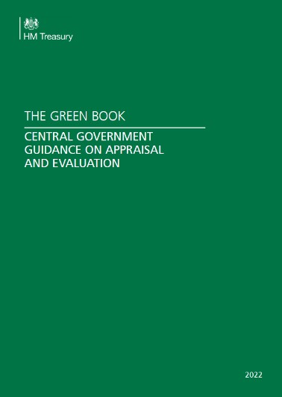
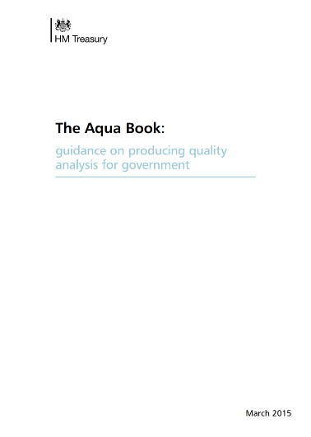
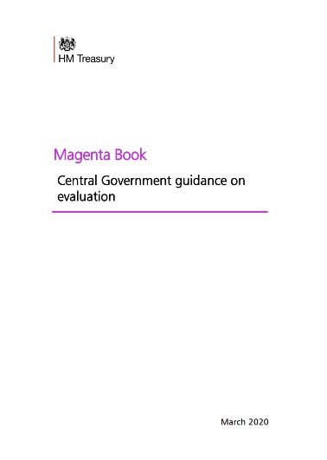
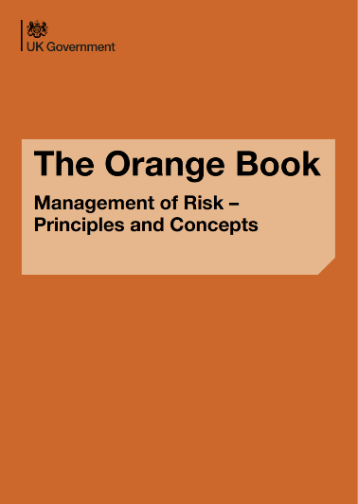
UK GOVERNMENT BEST PRACTICES
The government publishes extensive guidance for operating in the public sector; this guidance can be referenced within proposals and to demonstrate adherence to best practices
THE GREEN BOOK THE AQUA BOOK THE MAGENTA BOOK THE ORANGE BOOK
Offers guidance on the appraisal and evaluation of policies, programs, and projects
Provides a framework for assessing VfM and ensuring consistency across government and the wider public sector
Good practice guide for individuals working with analysis and analytical models
Offers guidance on improving analytical quality assurance and includes templates and specific analysis techniques
Provides evaluation methods and techniques for government policies, programs, and projects.
Includes guidance on conducting regulatory post- implementation reviews
Provides guidance on managing risk within government organisations
Includes a Risk Appetite Guidance Note document and offers recommendations for effective risk management

Slide 13
DEEP-DIVE ON THE ‘GREEN BOOK’: BUSINESS CASES (1/3)
The Green Book sets out three stages for the appraisal of business cases
Illustrative
Introduction to the Green Book
What are the business case stages to appraise a project?
The Green Book is guidance issued by HM Treasury on how to appraise policies, programmes and projects. It also provides guidance on the design and use of monitoring and evaluation before, during and after implementation
It is mandatory to employ the Green Book in a “proportionate” way
where the use of significant new and existing public resources
is required
Departments also produce internal guidance, setting out how Green Book appraisal should be carried out for their areas of responsibility
The Green Book adopts the Five Cases model (see next slide) to foster cross-disciplinary thinking on key topics
Programmes (who are seen to be enabling outcomes rather than outputs) must submit a separate Programme Business Case using the Five Case Model
Strategic Outline Case
(SOC)
Outline Business
Case (OBC)
Full Business
Case (FBC)
Confirms compliance with specific standards, regulations, or requirements Provides evidence that an organization has implemented necessary controls and practices Demonstrates adherence to industry best practices and regulatory guidelines | Outlines the rationale for a proposed project Describes the project's objectives, benefits, costs, risks, and potential alternatives Helps stakeholders understand the project's viability and potential value | Builds upon the OBC and provides a detailed analysis of a proposed project Includes a thorough assessment of costs, benefits, risks, and potential impacts Assists decision- makers in evaluating the project's feasibility, value for money, and alignment with strategic objectives

Slide 14
DEEP-DIVE ON THE ‘GREEN BOOK’: BUSINESS CASES (2/3)
The Green Book also sets out the “five case model” which is best practice for the execution of business cases
Illustrative
Summary of the Five Case model
Distribution of the five-case model across a three-stage business case
The Five Case Model is the best practice standard recommended by HM Treasury and has been used successfully by UK Government departments and the wider public sector for many years
Application of this methodology has been shown to:
Reduce the costs and timescales associated with producing business cases
Raise the quality of spending proposals, both in terms of their scoping and delivery and public value
Support the prioritisation of spending proposals and the management of spending portfolios
It has five key dimensions:
Strategic Dimension – outlines the need for change and expected outcomes
Economic Dimension – assesses social value versus Business as Usual
Commercial Dimension – examines the feasibility of a commercial deal
Financial Dimension – analyses the proposal’s impact on public finances.
Management Dimension – evaluates the realism and robustness of delivery plans
Strategic
Economic
Commercial
SOC OBC
Financial
Management
FBC
Source: UK Government, Oliver Wyman analysis

Slide 15
DEEP-DIVE ON THE ‘GREEN BOOK’: BUSINESS CASES (3/3)
The development of the five-case model is distributed across the three stages of business case development
 | SOC | OBC | FBC
Strategic What is the case for change? What is the strategic fit? | Strategic context Alignment to existing policies and organisational strategic Case for change Potential scope and service requirements Main benefits and risks Constraints and dependencies | Revisit SOC and confirm shortlist options remain valid | Confirm that case for change remains as set out in OBC and that spending objectives are SMART
Economic What is the public value to society? | Critical success factors Long and short-listed options | Economic appraisals for short-list options (NPSC/NPSV) Benefits appraisal Risk assessment Preferred option (including sensitivity analysis | Confirm options identified in OBC are still valid and thinking remains the same Detail procurement arrangements and evaluation best and final offers
Commercial Is the project viable? Is the deal with service providers well structured? |  | Procurement strategy Service requirements Payment mechanisms Key contractual arrangements Impact on income and expenditure account Affordability of funding Confirmation of stakeholder support | Set out negotiated deal and contractual arrangements
Financial Is the project affordable? |  | Capital and revenue requirements for preferred option Impact on balance sheet | Set out financial implications of the deal
Management What arrangements are in place for deliver, monitoring and evaluation? |  | Programme and project governance Use of specialist advisors Contract management arrangements Benefits realisation arrangements Risk management arrangements Post implementation evaluation arrangements | Finalise arrangements and plans for: Project management Risk management Contract management Post-project evaluation

Slide 16
DEEP DIVE ON RISK MANAGEMENT: THREE LINES OF DEFENCE MODEL
The 3LoD provides a clear framework for effective risk management, accountability, and governance, ensuring that risks are identified, assessed, and managed appropriately during the transformation process
What are the three lines of defence?
Extensive UK Government guidance on risk management can be found in the Orange Book
How are the three lines of defence structured?
1ST LOD
Responsible for the implementation of day-to-day risk management
Reports into programme management
Board/Audit Committee
Senior Management
2ST LOD
Independent oversight of the risk profile and risk management framework, providing:
Effective challenge to activities and decisions that materially
affect the organisation’s risk profile
Development, maintenance and enhancement of the risk management framework
1ST LOD
2ST LOD
Financial control
Risk Management Quality
External consultants (e.g. Programme assurance or deep- dives)
3ST LOD
Day to day management
Independent assurance
(e.g., internal audit)
3ST LOD
Independent assurance provided by independent body (e.g. internal audit by GIIA)
Ensures that the first two lines of are operating effectively and provides advice on how they could be improved
Tasked by, and reports to the board/audit committee, it provides an evaluation, through a risk-based approach, on the effectiveness of governance, risk management, and internal control to the
organisation’s governing body and senior management
Application of controls
Independence from management Responsibility for risk management
Source: Institute of Internal Auditors; UK government; OW analysis

Slide 17
DEEP DIVE ON RISK MANAGEMENT: ADDITIONAL DETAIL ON 3LOD
A variety of risk management practices can be employed across the three lines of defence to ensure the control environment is functioning effectively
How are the three lines of defence executed in practice?
 | 1ST LOD | 2ND LOD | 3RD LOD
 | Day to day management and delivery teams | Internal functions that oversee or specialise in risk management External resource conducting assurance (e.g., OW) | ^{IPA} Could be conducted by _{NAO} OW but we are yet to work in this space GIIA Commercial internal auditors
Conducted by
Processes | Identification, assessment and management of risks Design and implementation of effective internal controls Supervision of execution and monitoring of adherence Implementation of corrective actions to address deficiencies (including as a result of recommendations from 2nd and 3rd line assurance) | Assist management in developing controls in line with good practice Monitor compliance and effectiveness of controls Alert senior management of emerging issues and changing risks scenarios where appropriate | Objective evaluation of effectiveness of framework of governance, management and control Proactive evaluation of management risk controls Advise on potential control strategies and design of controls
 | Risk register RAID log | Risk and control matrix | Interviews Documentation review Internal audit reporting
Tools
Source: UK Government Orange Book

